Slide 1
Drug Target protein interaction prediction by PSSM and LOOP method

Slide 2
TEAM MEMBERS AND GUIDE
C. Vijayabaskar
2017103048
G. Velmurugan
2017103047
K. Sathish Kumar
2017103588
G. Sudhakaran
Teaching Fellow
Department of Computer Science and Engineering
College Of Engineering Guindy
Anna University

Slide 3
INTRODUCTION
Drug-Target Interaction Prediction (DTI) is an important application of machine learning in medicine industry, the importance is coming from the fact that we need to save the time and cost of the drugs development.
Drug is a chemical substance, typically of known structure, which, when administered to a living organism interacts with protein (targets) in the body to change their physiological function this can often be noticed through a protein’s phenotype (outward expression of protein).
. Proteins are made up of chained combinations of amino acids and do not have a fixed length, the amino acids come from the amino acid alphabet of length 20 but proteins can have any length e.g. 678.

Slide 4
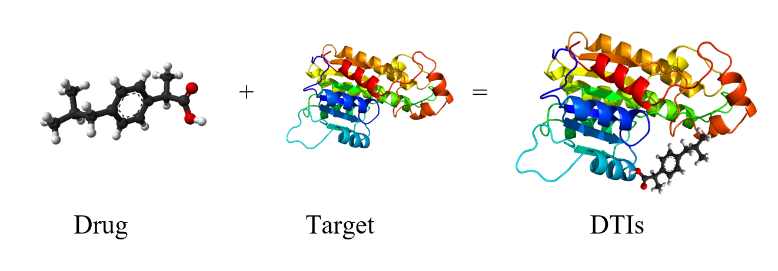
INTRODUCTION
Computational methods for DTI prediction are divided into 3 main approaches:
Ligand based
Docking simulation
Chemogenomic

Slide 5
OVERALL OBJECTIVES
The main objective of the project is to predict the interaction of drug and target. So, we propose a novel computational method based on target protein sequence and drug substructure fingerprints.
It uses the Chemogenomic approach of predicting the interaction. The method combines local optimal oriented pattern (LOOP), position specific scoring matrix (PSSM) and rotation forest (RF) for predicting DTIs.
Specially, we first transform the target protein sequence into PSSM in order to retain biological evolutionary information, and consider molecular substructure fingerprints are considered as the feature of drugs.
We then applied local optimal oriented pattern (LOOP) to extract the 256 dimension feature vectors from PSSM. Finally, we utilize rotation forest to predict the DTIs.

Slide 6
LITERATURE SURVEY
TITLE | AUTHOR | YEAR | METHOD | DRAWBACK | ADVANTANGE | IDEAS FOR ADOPTION
Prediction of Biological Targets for Compounds Using Multiple-Category Bayesian Models Trained on Chemogenomics Databases | Nidhi, Meir Glick, John W. Davies, and Jeremy L. Jenkins | 2006 | Multiple-Category Bayesian Models using chemogenomics database. | The automated nature of multiple-category naive Bayesian models trained on the knowledge in chemogenomics databases lends itself to the creation of very large predicted chemogenomics databases that would enable additional data mining. | Useful for improving knowledge in chemogenomics databases and for predicting new targets for orphan compounds. | Chemogenomic approach for prediction

Slide 7
LITERATURE SURVEY Contd..
TITLE | AUTHOR | YEAR | METHODS | DRAWBACKS | ADVANTANGE | IDEAS FOR ADOPTION
Neighborhood Regularized Logistic Matrix Factorization for Drug-Target Interaction Prediction | Yong Liu ,Min Wu,Chunyan Miao,Peilin Zhao,Xiao-Li Li | 2016 | Neighborhood Regularized Logistic Matrix Factorization | Lack of couple logistic matrix factorization with the multiple kernel learning techniques leads to low accuracy. | The neighborhood regularization based on the drug similarities and target similarities is utilized to further improve the prediction ability of the model. | Matrix way to preserve the features of the compound.
RFDT: A Rotation Forest-based Predictor for Predicting Drug-Target Interactions Using Drug Structure and Protein Sequence Information | Wang, Lei; You, Zhu-Hong; Chen, Xing; Yan, Xin; Liu, Gang; Zhang, Wei | 2018 | computational model is developed from (PSSM)Position Specific Scoring Matrix | No improvement in inferring unknown drug-target interaction | It gives variable importance for drug testing results which helps in determining the variable which impacts positively in prediction. | Rotation Forest algorithm and PSSM.

Slide 8
LITERATURE SURVEY Contd..
TITLE | AUTHOR | YEAR | METHODS | DRAWBACKS | ADVANTANGE | IDEAS FOR ADOPTION
Drug–target interaction prediction by learning from local information and neighbors | Jian-Ping Mei, Chee-Keong Kwoh, Peng Yang, Xiao-Li Li, Jie Zheng | 2013 | Intuitive solution to the new candidate problem of (BLM)Bipartite Local Model by integrating a Neighbor-based Interaction-profile Inferring (NII) procedure | Deterioration in the prediction performance and limited exploration in local and global information in model learning | In this, the influence of neighbors based on their distances can be used in finding new drug/target more efficiently. | Importance of the neighbouring molecule information.
A Semi-Supervised Method for Drug-Target Interaction Prediction with Consistency in Networks | Hailin Chen,Zuping Zhang | 2013 | labeled and unlabeled interaction information of drugs and targets and developed a semi supervised model | Data incompleteness is another big issue for such prediction problem. Thus, the performance of our method could be further improved by integrating more verified drug-target interactions. | In this, predicting interactions for new drug compounds and predicting unknown interactions of the given network are the advantages. | Semi supervised learning.

Slide 9
LITERATURE SURVEY Contd..
TITLE | AUTHOR | YEAR | METHODS | DRAWBACKS | ADVANTANGE | IDEAS FOR ADOPTION
DTIRF: Predicting Drug-Target Interactions Based on Improved Rotation Forest from Drug Molecular Structure and Protein Sequence | Zhu-Hong You,Li-Ping Li Xin Yan,Wei Zhang,Hai-Feng Wang,Zaozhuang University | 2019 | New in silico approach, named DTIRF, to predict the DTI combine feature weighted Rotation Forest (FwRF) classifier with protein amino acids information. | Executed less number of feature extraction algorithm to predict DTI. | In this, the feature extraction is very effective, and the designed classifier has high recognition performance. | Implementation of rotation forest with drug structure.
Manifold regularized matrix factorization for drug-drug interaction prediction | WenZhangab,Yanlin,Chenc,Dingfang,LicXiang,Yue | 2018 | A novel computational method named “Manifold Regularized Matrix Factorization” (MRMF) to predict potential drug-drug interactions (DDIs) | No accurate methods on how to combine diverse features in a manifold regulation | MRMF model achieves high-accuracy performance on the benchmark dataset, and outperforms other state-of-the-art methods. | Regularized matrix factorization(PSSM)

Slide 10
LITERATURE SURVEY Contd..
TITLE | AUTHOR | YEAR | METHODS | DRAWBACKS | ADVANTANGE | IDEAS FOR ADOPTION
Drug-Target Interaction Prediction through Label Propagation with Linear Neighborhood Information | Wen Zhang ,Yanlin Chen and Dingfang Li | 2017 | Label Propagation method with Linear Neighborhood Information (LPLNI) for predicting unobserved drug-target interactions | This experiment doesn’t show how to utilize the unknown data for drug-target interaction. | Experimental results demonstrate that integrated information (LPLNI-II) can produce improved performances, better than other state-of-the-art methods. | Importance of linear neighbouring compound in drug molecule.

Slide 11
Overall issue
Identifying drug-target interactions (DTIs) is a major challenge in drug development. Traditionally, similarity-based methods use drug and target similarity matrices to infer the potential drug-target interactions. But these techniques do not handle biochemical data directly.
Chemical compound react to one another based on many properties. Since it is not easy to carry all the physical and chemical properties in the training process the accuracy of the prediction is low.
Data incompleteness is the major issue for such prediction problem. Since it is related to drugs and chemical compounds the complete data is hard to achieve. Many sources have data with incomplete information.
No fixed and standard method for extracting the whole and accurate feature of the chemical compound.

Slide 12
Proposed system
In this work, they proposed a way of predicting the DTIs using position specific scoring matrix and finger print vector.
We modified the way of vectorization of fingerprint by Morgan fingerprint, which stores 2048 bits for the molecular substructure. By storing more bit of the molecular substructure we can carry more information to further level.
We also modify the PSI-Blast search by including the search with the aligned sequence rather than the ordinary sequence.
For our contribution we included the ligand based drug feature (solubility, binding strength) for classification

Slide 13
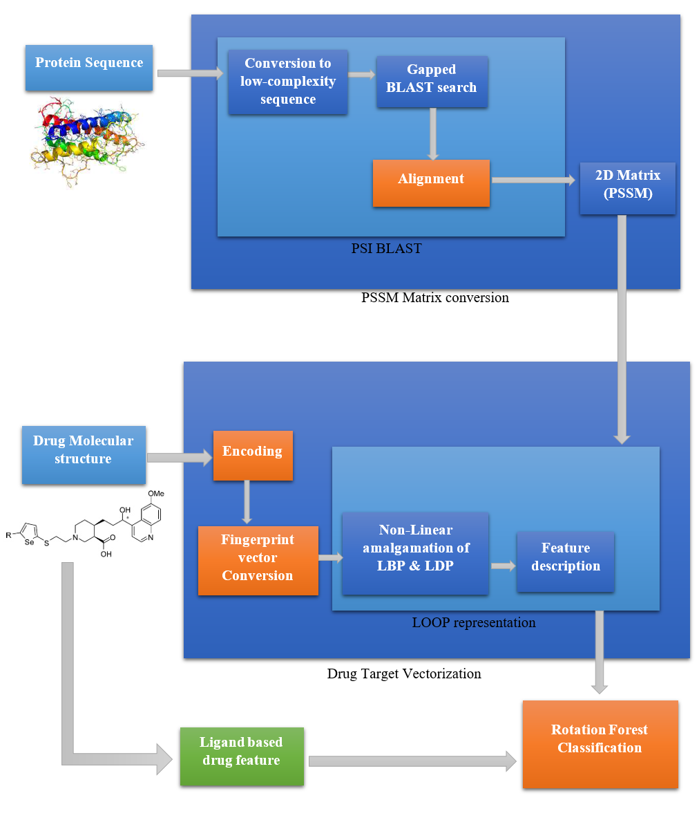
Architecture Diagram

Slide 14
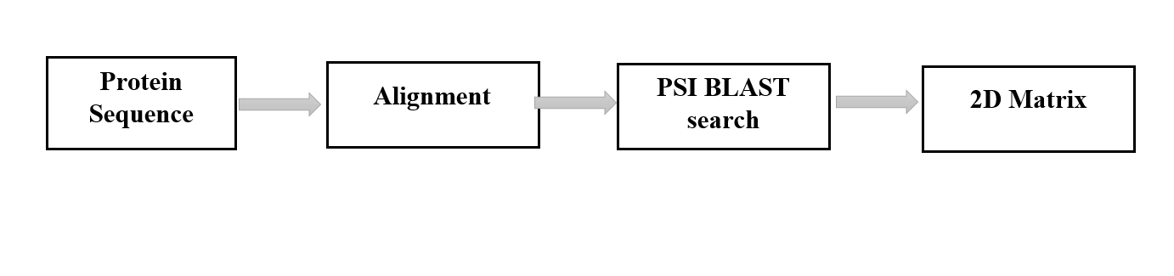
Details Of Module
PSSM Matrix conversion:
A PSSM, or Position-Specific Scoring Matrix, is a type of scoring matrix used in protein BLAST searches in which amino acid substitution scores are given separately for each position in a protein multiple sequence alignment.

Slide 15
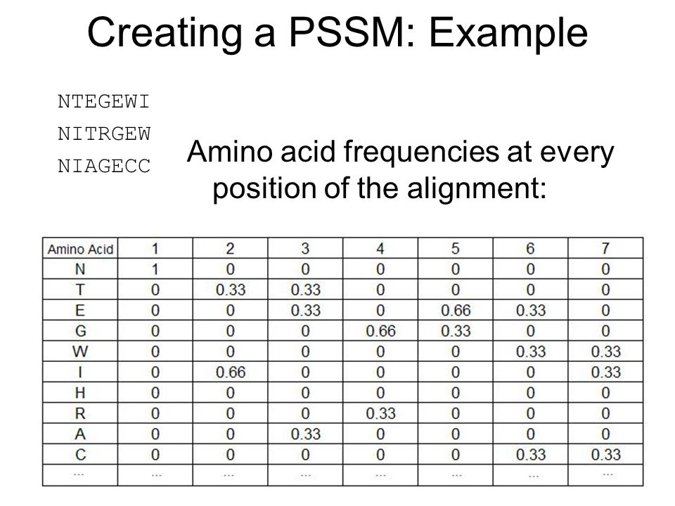
Details Of Module
PSSM Matrix conversion:
INPUT | OUTPUT | ALGORITHM
Protein sequence e.g:MAESASPPSSSAAAPAAEPGVTTEQPGPRSPPSSPPGLEEPLDGADPHVPHPDLAPIAFFCLRQTTSPRNWCIKMVCNPWFECVSMLVILLNCVTLGMYQPCDDMDCLSDRCKILQVFDD Each letter represents an amino acid. Protein is generally a sequence of amino acid. | 2D Matrix E.g: The column represents the length of the protein sequence and row is 20 (Number of available amino acids). The value contains the frequency of that amino acid at that position in that sequence. | Input protein sequence Run PSI-Blast with 3 iteration Normalize each value in range 0-1 Sum up all rows to same amino acid in primary sequence Resultant matrix is 20x20

Slide 16
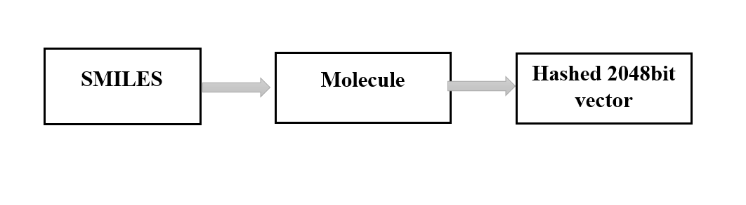
Details Of Module
Fingerprint Vectorization:
Molecular fingerprints are a way to represent molecules as mathematical objects. By doing this, we can perform statistical analyses and/or machine learning techniques on the set of molecules to gain new insights that we could not gain as humans.
One of the most common molecular fingerprinting methods is Extended Connectivity Finger Printing (ECFP).

Slide 17
Details Of Module
Fingerprint Vectorization:
INPUT | OUTPUT | ALGORITHM
SMILES (Chemical formula) Eg: N[C@@H](CC(O)=O)C(O)=O | Morgan Fingerprint (2048 bit vector) 01000000000000000000000000000000000000000100000……00000000000000000000000000000000 (2048 bits) Each set bit represent a molecular compound. | Assign each atom with identifier. Update each atom’s identifiers based on its neighbours. Remove Duplicates. Fold list of identifiers into 2048-bit vector (a Morgan Fingerprint)

Slide 18
Details Of Module
LOOP Formation:
This letter introduces the LOOP binary descriptor (local optimal oriented pattern) that encodes rotation invariance into the main formulation itself. This makes any post processing stage for rotation invariance redundant and improves on both accuracy and time complexity.
INPUT | OUTPUT | ALGORITHM
2D PSSM matrix | 256 feature vector | Kirsch laplacian algorithm

Slide 19
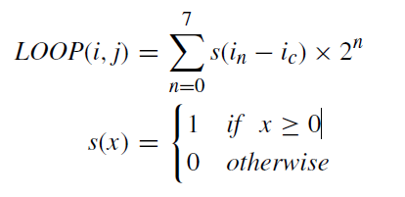
Details Of Module
LOOP Formation:
In LOOP algorithm, The LOOP feature is obtained by calculating for each image pixel using a 3x3 neighbourhood around each pixel.
Firstly, it computed the eight responses of the Kirsch masks, (ln; n D 0,1,..,7) corresponding to pixels with intensities (in; D 0,1,..,7) to obtain the intensity variation in the eight directions.
Secondly, based on the rank of the magnitude value ln, each pixel obtained different weight n. Finally, computing the LOOP code for the center pixel (i, j) as follows:

Slide 20
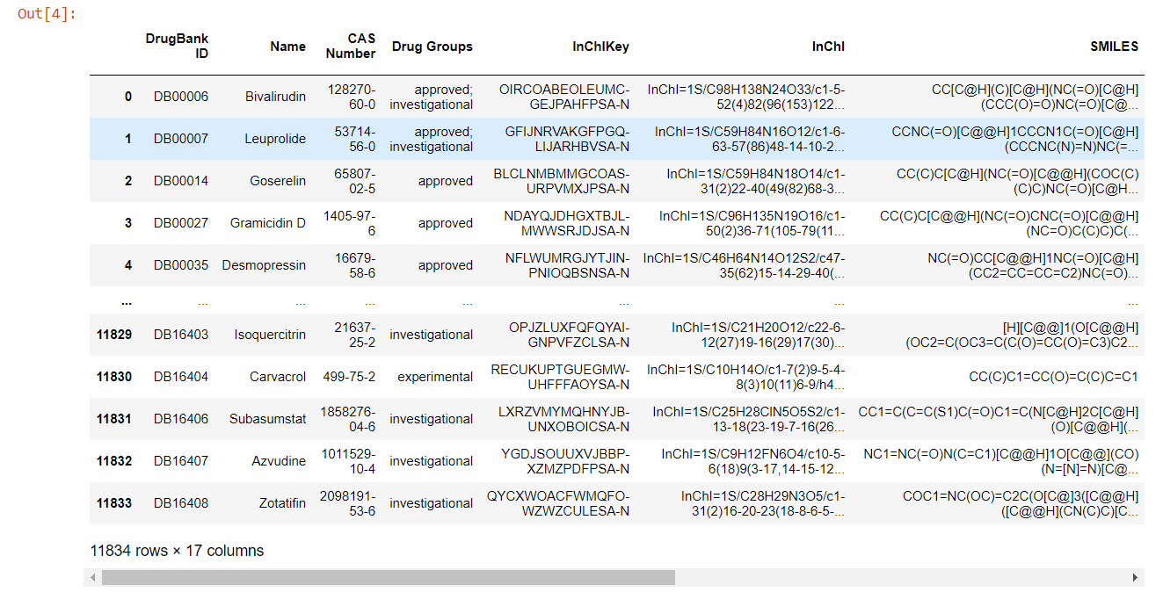
Implementation
As for the 30% implementation we have done the data pre-processing and fingerprint vector conversion.

Slide 21
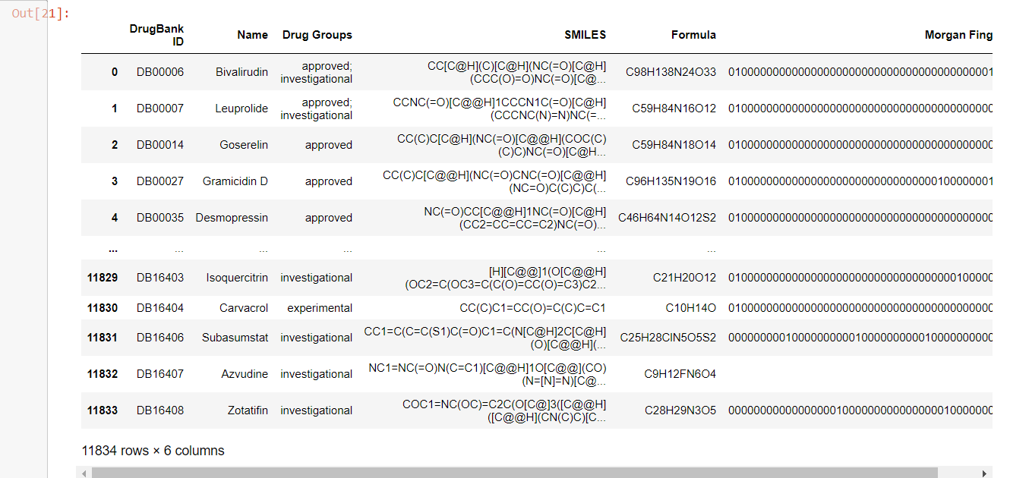
Implementation
After deriving the Morgan fingerprint from the SMILES, it is added to the existing drug data for future purpose.

Slide 22
Metric for evaluation
In order to evaluate the performance of the propose method, we use the evaluation measures such as the overall prediction accuracy (Accu.), sensitivity (Sens.), precision (Prec.), and Matthews correlation coefficient (MCC).
When predicting the DTIs datasets of enzyme, ion channels, GPCRs and nuclear receptor, five-fold cross-validation would be adopted in this work in order to avoid the over-fitting of the prediction model.
Accuracy = (TN+TP) / (TN+TP+FN+FP)
Precision = TP / (TP+FP)
Sensitivity = TP / (TP+FN)
Specificity = TN / (TN+FP)

Slide 23
Test cases
Bivalirudin (DB00006)
Expected output: 010000000000000000000000000000000000000001000000000000000000000000000000000000011000000000000000000…00000000000000000000000
Derived output:
010000000000000000000000000000000000000001000000000000000000000000000000000000011000000000000000000…00000000000000000000000
Result: Matched
Goserelin (DB00014)
Expected output: 010000000000000000000000000000000000000000000000000000000000000000000000000000011100000000000010000000000…0000000000000000000
Derived output:
010000000000000000000000000000000000000000000000000000000000000000000000000000011100000000000010000000000…0000000000000000000
Result: Matched

Slide 24
Dataset
In this study, we execute the experiment for predicting DTIs on four golden standard datasets, namely enzyme, ion channels, GPCRs, and nuclear receptor, respectively. These datasets are collected from DrugBank, KEGG BRITE, SuperTarget & Matador, and BRENDA which were considered as high-reliability databases.
Drugbank- https://go.drugbank.com/releases/latest

Slide 25
References
1. Xinkie Zhan , Zhu-Hong You (Member, IEEE), Jinfan Cai, Liping Li, Chanqing Yu, Jie Pan, and Jiangkun Kong “Prediction of Drug-Target Interactions by Ensemble Learning Method from Protein Sequence and Drug Fingerprint”.
2. Nelson R. C. Monteiro, Bernardete Ribeiro, Joel P. Arrais “Drug-Target Interaction Prediction: End-to-End Deep Learning Approach”.
3. Y. Yamanishi, E. Pauwels, and M. Kotera, ``Drug side-effect prediction based on the integration of chemical and biological spaces, Nov. 2012.
4. M. Kuhn, M. Al Banchaabouchi, M. Campillos, L. J. Jensen, C. Gross, A. Gavin, and P. Bork, ``Systematic identification of proteins that elicit drug side effects,'' Jan. 2013.
5. A. Ezzat, M. Wu, X.-L. Li, and C.-K. Kwoh, ``Drug-target interaction prediction via class imbalance-aware ensemble learning,''Dec. 2016.
6. S. M. Paul, D. S. Mytelka, C. T. Dunwiddie, C. C. Persinger, B. H. Munos, S. R. Lindborg, and A. L. Schacht, ``How to improve R&D productivity: The pharmaceutical industry's grand challenge,''Feb. 2010.
7. F. Zhu, B. Han, P.Kumar, X. Liu, X. Ma, X.Wei, L.Huang,Y. Guo, L. Han,C. Zheng, and Y. Chen, ``Update of TTD: Therapeutic target database,''Jan. 2010.
8. Y. Wang, S. Zhang, F. Li, Y. Zhou, Y. Zhang, Z.Wang, R. Zhang, J. Zhu,Y. Ren, Y. Tan, C. Qin, Y. Li, X. Li, Y. Chen, and F. Zhu, ``Therapeutic target database 2020: Enriched resource for facilitating research and early development of targeted therapeutics,'' Jan. 2020.

